Slide 1
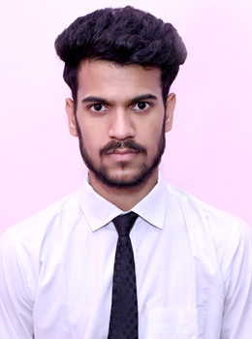



Harshvardhan Singh Kaurav
Analyst/Software Engineer
Bachelor of Engineering
Computer Science : 2018 - 2022
Skills Java 8 /J2EE
Spring Boot
Spring MVC
JPA CRUD
Bootstrap
MERN Stack
ReactJS
NodeJS
ExpressJS
MongoDB
Database
SQL database – Oracle, MySQL
No SQL database – MongoDB
Web Technologies
HTML5
CSS3
Javascript
AddOns
Github
Maven
Postman
Additional Details
Leadership
Excellent Communication Skills
Team management
Mumbai
harshvardhan-singh.kaurav@capgemini.com
+91 9171411428
A4
Software Engineer who is always ready to learn new technologies and try to solve problem with them and Always ready to take new challenge.
Ready to learn new technologies and implement them to further improve my knowledge.
I am a team player. I believe in teamwork and always ready to serve a key role in project to improve it.
I have knowledge on ReactJS, Java and Spring Microservices development on intermediate level.
Also have knowledge about MongoDB, and other technology which is related to web development like Spring Security.
Railway Reservation Application
Completed end to end case study of Railway Reservation Application along with JWT authentication, Swagger and payment Gateway using Paytm . Material-UI and React Bootstrap used for user interface.
To Do List Application
Developed To do list application using nodeJS and ReactJS for backend and frontend respectively and used mongoDB as a database.
Web Development bootcamp on UDEMY
Completed this course and complete all the assignment throughout the course and learnt about HTML, CSS, Javascript and ReactJS.
Made a Personal Portfolio reflecting all my education and my courses
Check out my work on GitHub & Video Profile

